Slide 1
INTERNSHIP REPORT BCA - Data Science | Sem 3 | JUNE 2024
Name : SURAJ RAVISHANKAR YADAV Reg. No. : EC2331201010110
Under the Guidance of Prof. Muthuselvam

Slide 2
Topic
Bank Note Authentication Web APP using Python, Machine Learning, Github & Streamlit

Slide 3
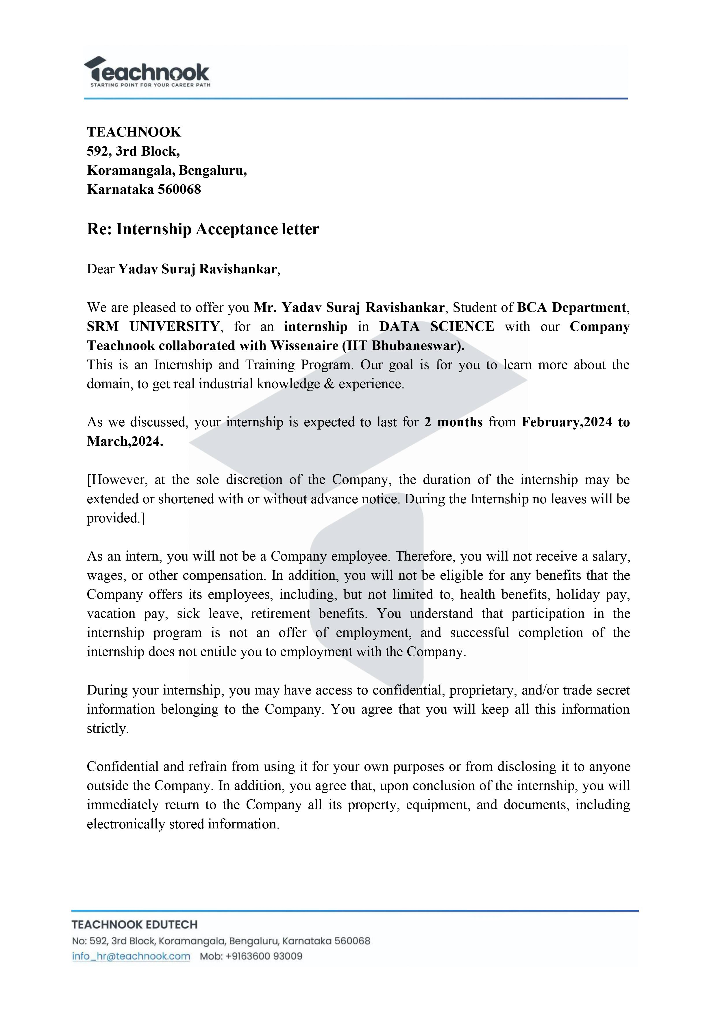

Slide 4


Slide 5
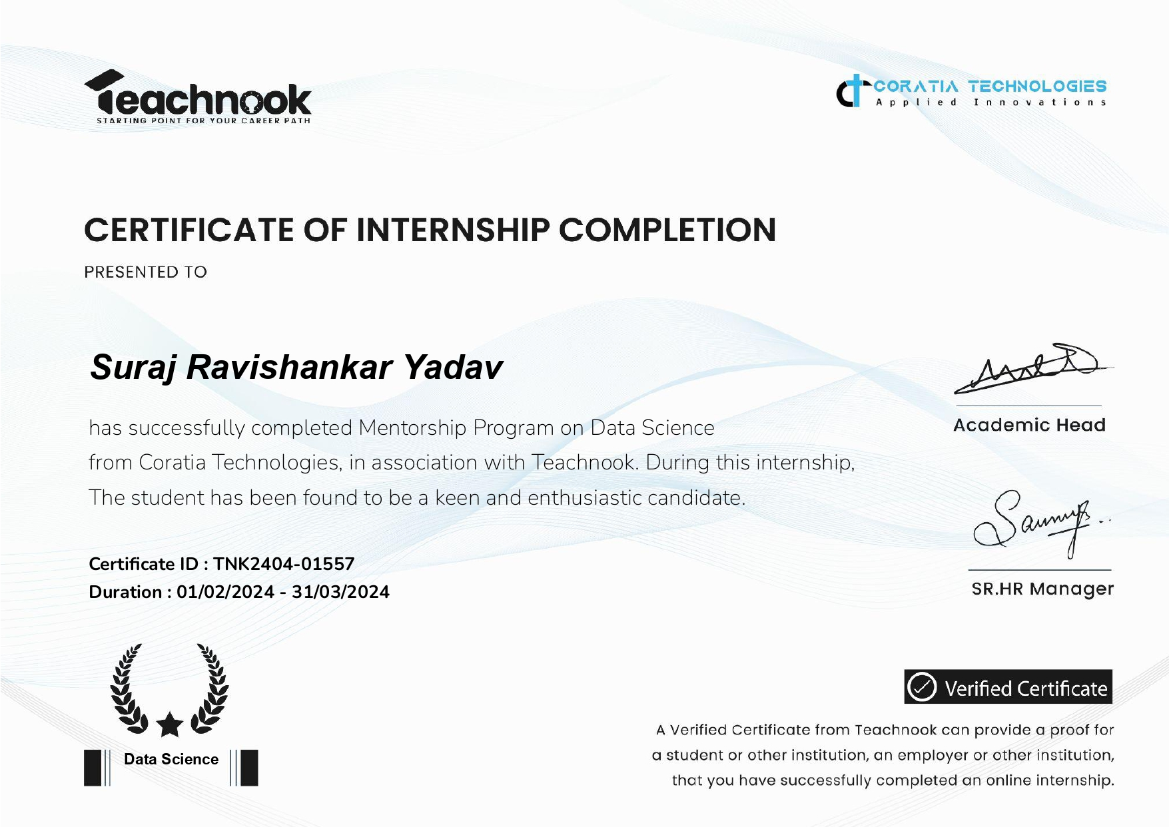

Slide 6


Slide 7
Abstract
The banknote authentication project is aimed at developing a machine learning model that can accurately differentiate between genuine and counterfeit banknotes.
The project proposes the use of machine learning techniques to evaluate the authentication of banknotes.
The dataset used in the project is sourced from the UCI Machine Learning Repository and contains images of genuine and forged banknote-like specimens.

Slide 8
Supervised learning algorithms such as Logistic Regression, Decision Tree Classifier, Random Forest Classifier, Support Vector Machine (SVM), and Naive Bayes Classifier were used to differentiate between genuine and fake banknotes.
The study shows a comparison of these algorithms in the classification of banknotes, and the machine learning web application developed using the project uses random forest classifications with 99.27% accuracy to assess the authenticity of original or counterfeit notes, along with many other note features such as variation, curvature, kurtosis, and entropy.
The model has been saved in a joblib file format so that it can be used later to deploy and streamlit has been used to deploy the machine learning model.

Slide 9
Tools & Technologies
Python
Numpy
Pandas
Seaborn
Matplotlib
Scikit-learn
Anaconda Navigator
Jupyter Notebook
Excel
Machine learning algorithms
Logistic Regression
Decision Tree Classifier
Random Forest Classifier
Support Vector Machine (SVM)
Naive Bayes Classifier
Github
Streamlit
Notepad++

Slide 10
implementation
Problem Statement
Data Understanding
Importing Libraries
Loading the dataset
Exploratory Data Analysis
Data Visualization
Data Cleaning
Feature Selection
Train-Test Split
Feature Scaling
Modeling Training
Model Performance
Performance Analysis
Saving Model
Loading Model
User Interface Design
Testing
Deployment
Result
Conclusion

Slide 11
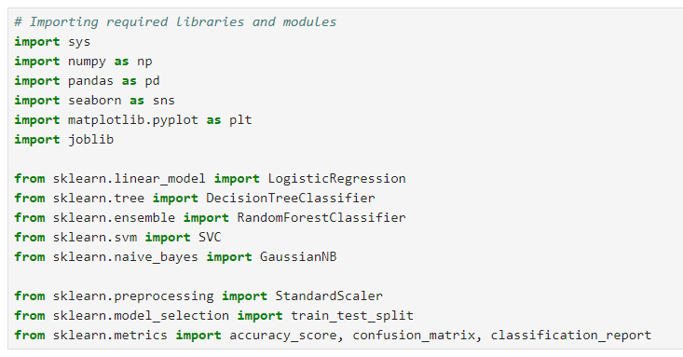
1. Importing Libraries

Slide 12
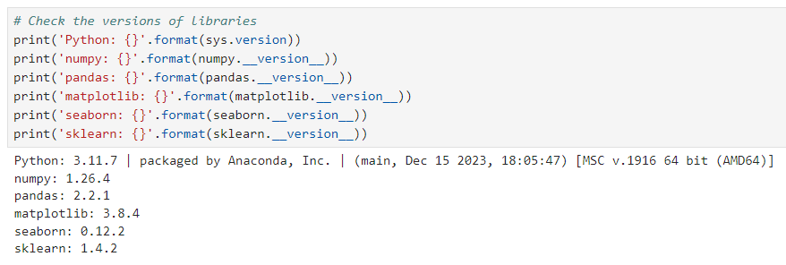
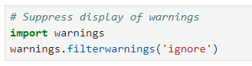
2. Checking versions of libraries
2.1 Supressing Warnings

Slide 13
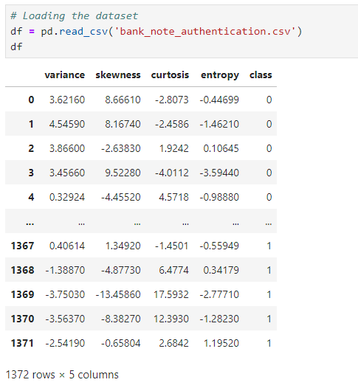
3. Loading dataset

Slide 14
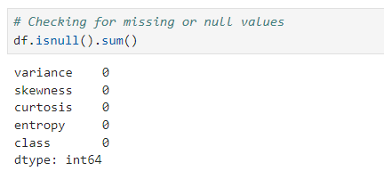
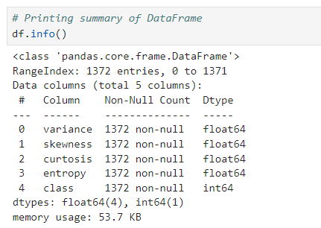
4. Exploratory Data Analysis (EDA)
4.1 Checking Missing Values
4.2 Summary of Dataset

Slide 15
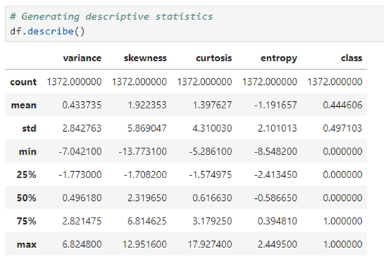
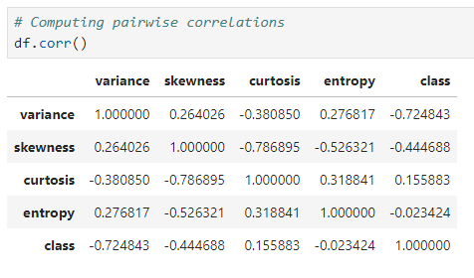
4.4 Pairwise Correlations
4.3 Descriptive Statistics

Slide 16
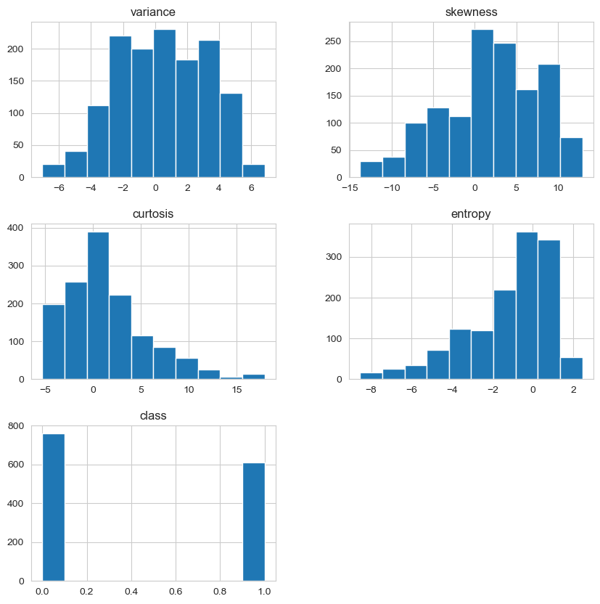
5. Data visualization
Distribution of Variables
Conclusion:
The variance, skewness, and curtosis features are approximately normally distributed, with bell-shaped curves centered around the mean values.
The entropy feature is slightly skewed to the right, with a longer tail towards the higher values.
The histograms do not show any obvious outliers or data quality issues, which is a good sign for building a model.
The histograms of the class feature show that the dataset is slightly imbalanced towards the positive class, with more samples in the positive class than in the negative class.

Slide 17
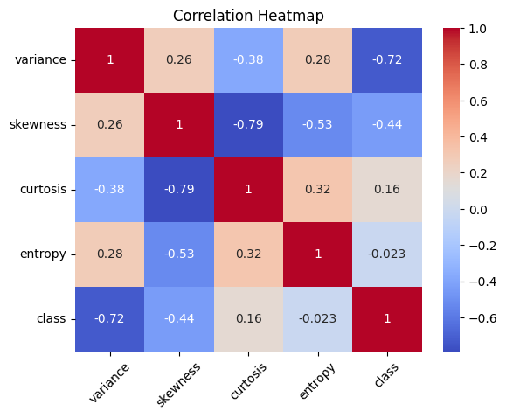
Correlation Heatmap
Conclusion:
The correlation matrix shows that there is a strong negative correlation between the 'class' variable and the other numerical variables, particularly 'variance' and 'curtosis'. This suggests that these variables may be important for predicting the class variable.
There is a moderate positive correlation between 'skewness' and 'entropy', and a moderate negative correlation between 'variance' and 'skewness'.
There is a weak positive correlation between 'variance' and 'entropy', and a weak negative correlation between 'skewness' and 'curtosis'.
The heatmap shows that the correlation between 'class' and 'entropy' is close to zero, indicating that these variables are not strongly related.
Also, from the above heatmap, we can see their is a multicolliniraty between curtosis and skewness but can be ignored.

Slide 18
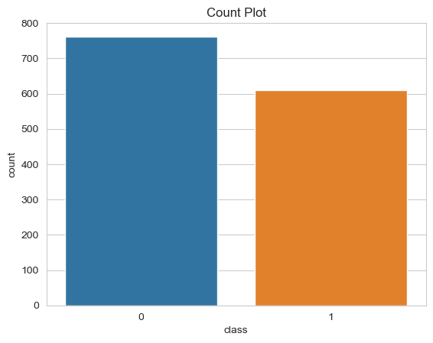
Count plot
Conclusion:
The countplot shows that the dataset is slightly imbalanced towards the positive class, which has more samples than the negative class.
This is consistent with the observation from the histograms of the class feature.

Slide 19
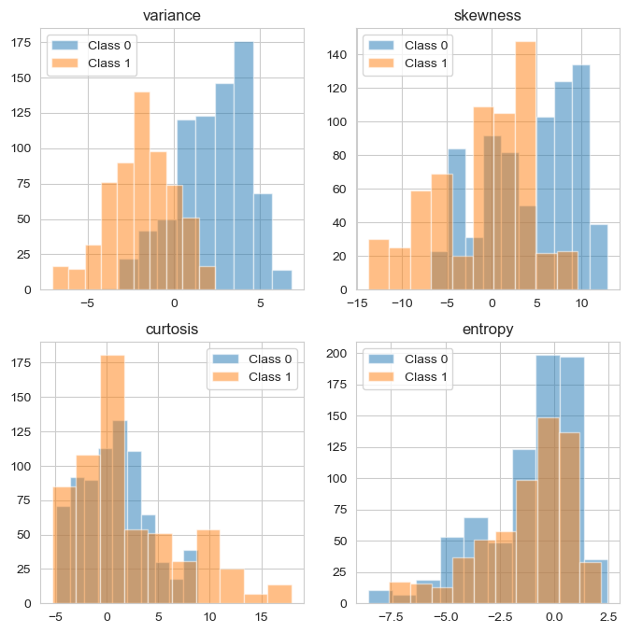
Class Distribution of Features
Conclusion:
Most of the features nearly follow a normal distribution.
From the plots it is understood that 'variance' is a feature that can help distinguish classes the most.
'Entropy' on the other hand exhibit the same distribution for both classes.

Slide 20
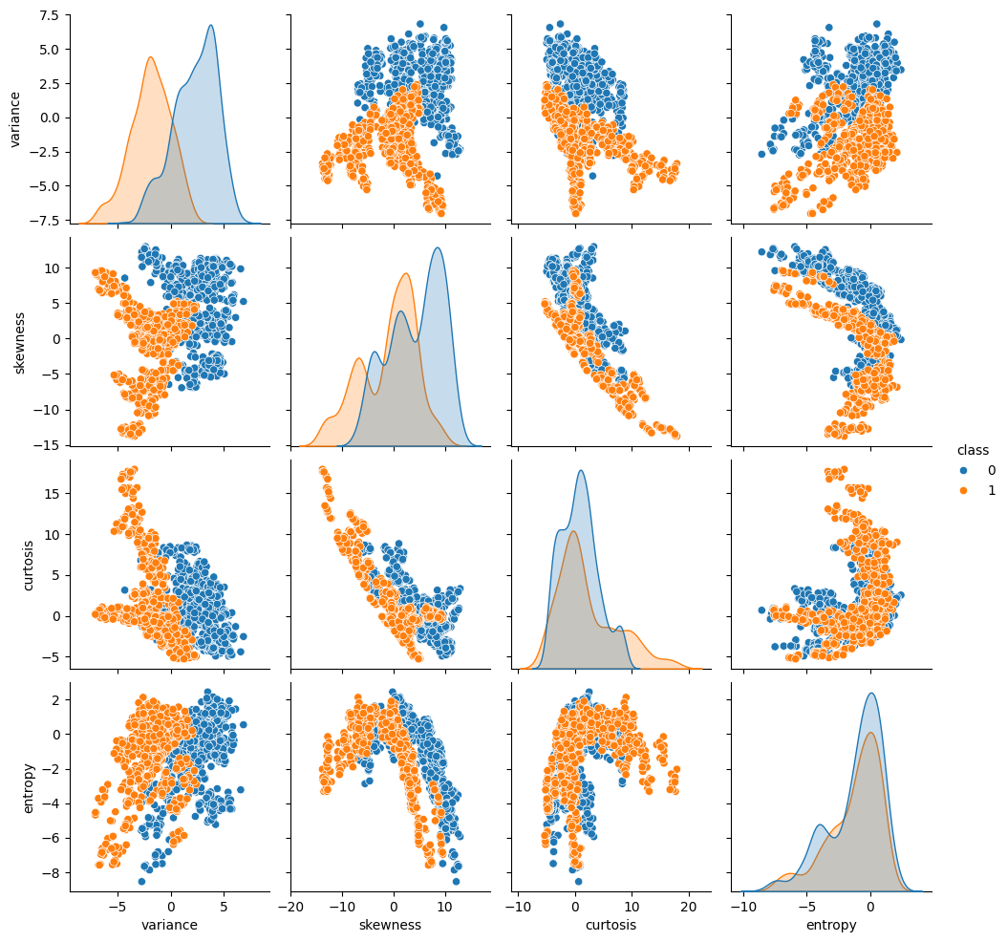
Features Pairplot
Conclusion:
There are clear separations shown, especially for pairs of features having 'variance’.
The curtosis-entropy scatterplot exhibits the lowest separation.

Slide 21
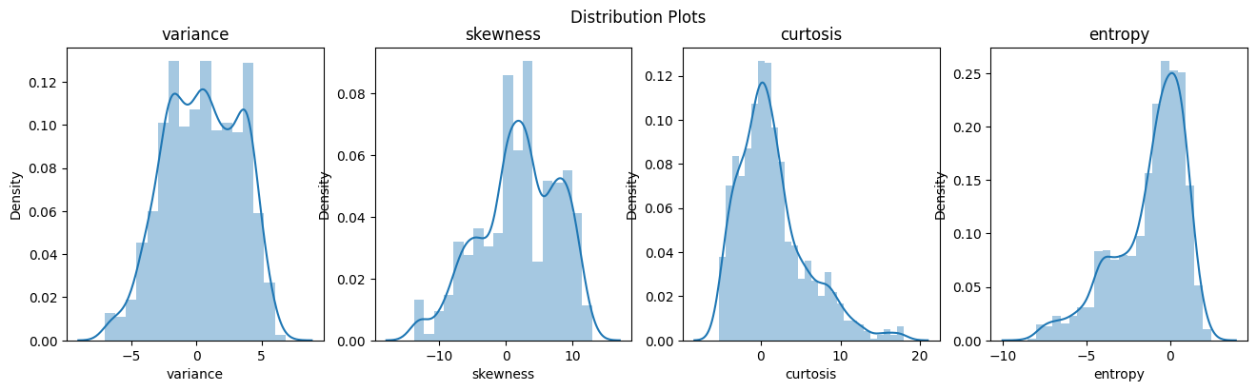
Distribution Plots
Conclusions:
1) Their may be outliers in entropy and curtosis column.
2) Data is not normalized.
3) Since we gonna use trees in our model above things don’t effect model much.

Slide 22
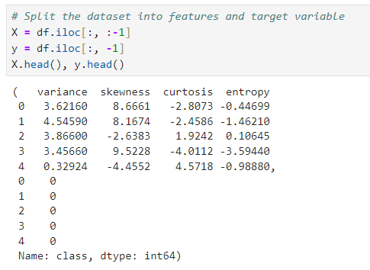
Train-Test Split
Splitting the Dataset into Features and Target Variable

Slide 23
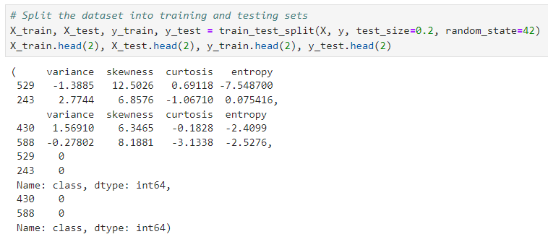
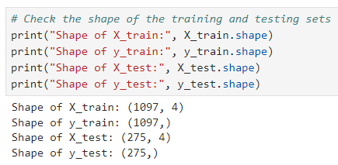
Splitting the Dataset into Training and Testing Sets
Checking the Shape of Training and Testing Sets

Slide 24
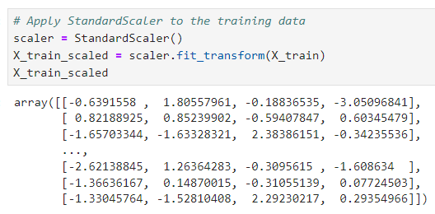
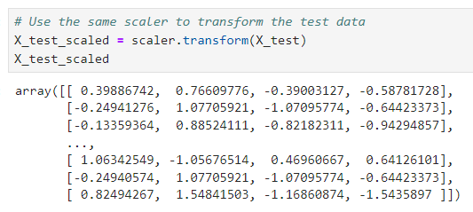
Feature Scaling
Applying StandardScaler
to the Training Data
Transforming the Test Data

Slide 25
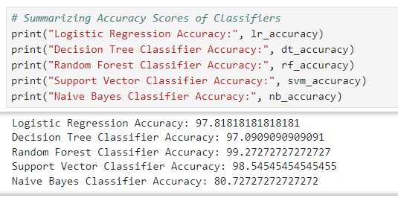
Summarizing Accuracy Scores

Slide 26
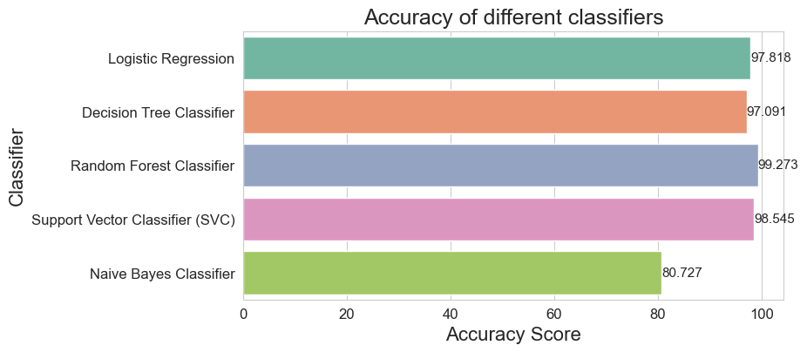
Visualizing Accuracy Scores

Slide 27
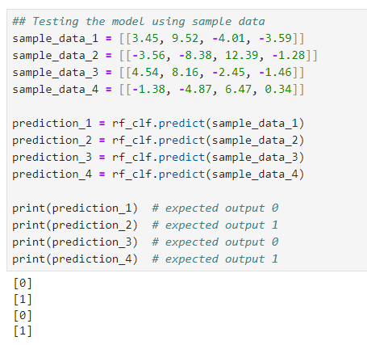
Testing

Slide 28
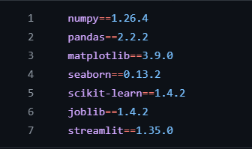
requirements.txt

Slide 29
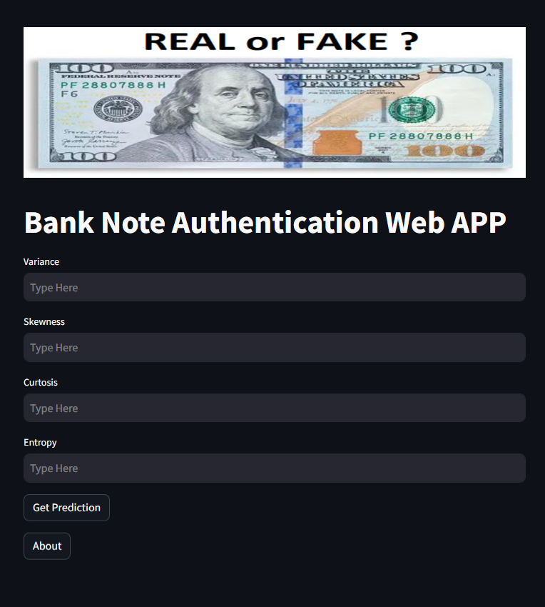

Slide 30
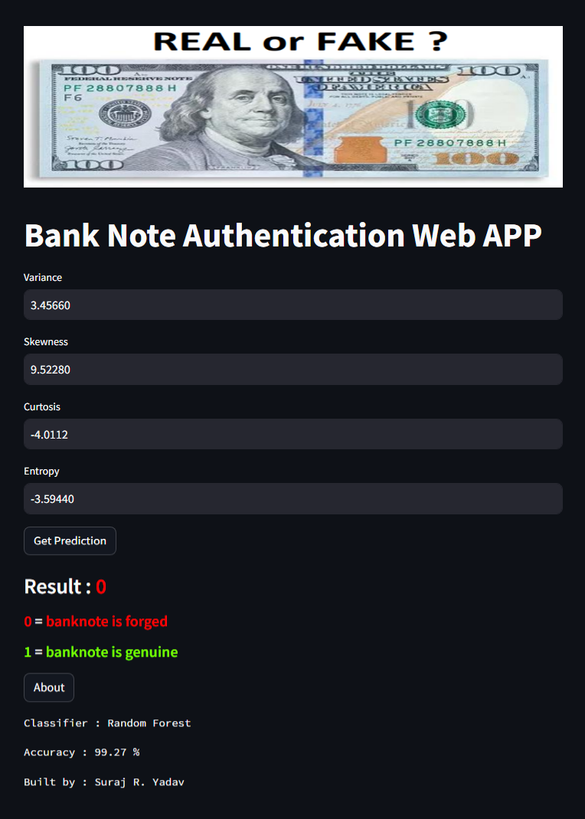

Slide 31
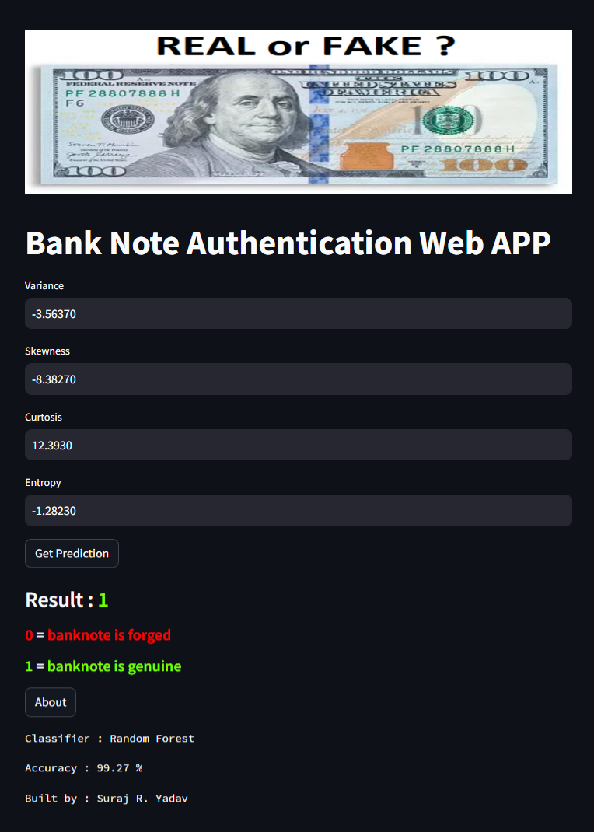

Slide 32
Conclusion
In conclusion, this project aimed to develop a machine learning algorithm for banknote authentication based on image features. We evaluated several machine learning algorithms, including Logistic Regression, Decision Tree Classifier, Random Forest Classifier, Support Vector Machine (SVM), and Naive Bayes Classifier and compared their performance.
Our results showed that all the algorithms performed well in terms of accuracy, with Random Forest Classifier achieving the highest accuracy, followed by SVM, Logistic Regression, Decision Tree Classifier, and Naive Bayes Classifier. Based on these results, we concluded that Random Forest Classifier was the most suitable algorithm for the banknote authentication problem. We provided a detailed explanation of how each algorithm was implemented in the project, including preprocessing steps, data scaling, and evaluation metrics.
Overall, this project demonstrated the importance of carefully selecting and evaluating machine learning algorithms for specific problems and the need for a thorough analysis and interpretation of the results. The findings and conclusions of this project can inform future research and development in the field of artificial intelligence and machine learning.

Slide 33
references
11.1 Online Resources
Dataset : https://archive.ics.uci.edu/dataset/267/banknote+authentication
W3schools : Python, Numpy, Pandas, Matplotlib, Seaborn, Machine Learning
Google : Machine Learning Crash Course
GeeksforGeeks : Machine Learning Algorithms
Great Learning : Machine-learning-tutorial
Datacamp : learn machine learning
Simplilearn : Machine learning Concepts
Tutorialspoint : Overall Machine learning
11.2 Books and Authors
Bishop, C. M. (2006). Pattern recognition and machine learning (Vol. 4). Springer.
Breiman, L. (2001). Random forests. Machine learning, 45(1), 5-32.
Cortes, C., & Vapnik, V. (1995). Support-vector networks. Machine learning, 20(3), 273-297.
Norving, Peter, and Stuart Russel. Artificial Intelligence: A Modern Approach. S.l.: Pearson Education Limited, 2013.
Quinlan, J. R. (1993). C4. 5: Programs for machine learning. Elsevier.
Raschka, S., & Mirjalili, V. (2017). Python Machine Learning. Packt Publishing Ltd.
Russell, S. J., & Norvig, P. (2010). Artificial intelligence: a modern approach. Pearson Education.

Slide 34


Streamlit Web APP link : https://bank-note-web-app.streamlit.app/ GitHub Project link : https://github.com/sryagit/bank_note_authentication

Slide 35
Thank you

